Slide 1
The Genetic of Cancer

Slide 3
Cancer terminology
Classification by tissue type:
carcinoma epithelial cell 90% of all tumours derived from ectoderm (mostly) or endoderm (some)
sarcoma connective tissue 2% of all tumours derived from mesoderm
leukaemia circulatory or lymphatic 8% of all tumours derived from mesoderm
Classification by the type of cells:
Adenomatous cells
Squamous cells flat cells
Myeloid blood cell
Lymphoid lymphocytes or macrophages

Slide 4
Cancer terminology
Classification by the site of origin of the tumour:
Breast: carcinoma of ductal, papillary, etc. cells
Lung: small cell, squamous, large cell carcinomas
Bone: osteosarcoma
Eye: retinoblastoma
Lip, tongue, mouth, nasal cavity: squamous cell carcinoma
Lymphocytes: acute lymphocytic leukaemia, chronic lymphocytic leukaemia, Hodgkin's lymphoma
Ovary: adenocarcinoma
Testis: seminoma, teratocarcinoma,

Slide 5
Cancer terminology
Benign tumours
are generally slow growing and enclosed in a fibrous capsule
are relatively innocuous, although their location can make them serious (such as a tumour located in the brain)
Malignant tumours
proliferate rapidly, invading neighbouring tissues
can metastasise, or spread, to other sites of the body
are named using the conventions of tissue, cell type, and origin add OMA
e.g. A tumour of the bone is an osteoma if benign and an osteosarcoma if malignant

Slide 6
Types of agents which may mutate to cause cancer:
Environmental agents
Genetical agents
Tumour suppressor genes
oncogenes
DNA repair genes
p53

Slide 7
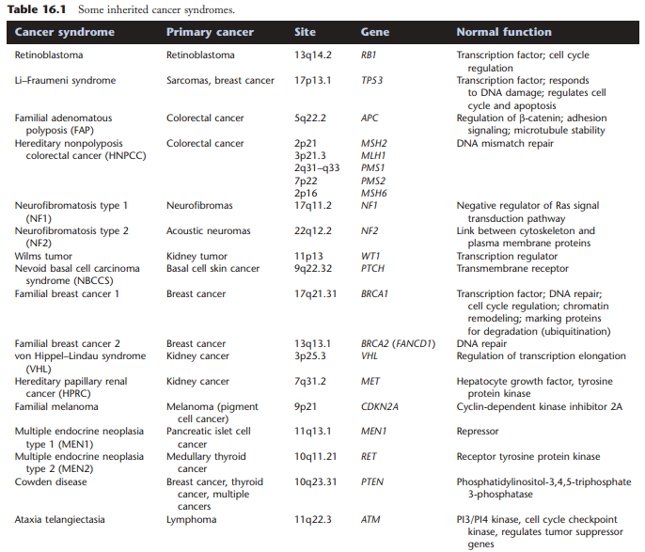

Slide 8
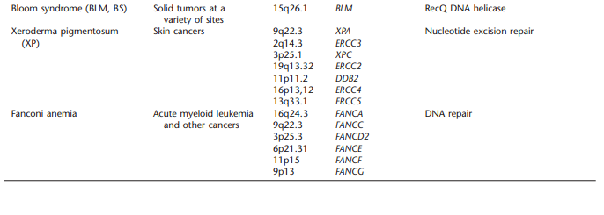

Slide 9
Tumour suppressor genes
The gene’s normal function is to regulate cell division. Both alleles need to be mutated or removed in order to lose the gene activity.
The first mutation may be inherited or somatic.
The second mutation will often be a gross event.

Slide 10
Tumor suppressor genes are usefully placed into two general groups, promoters and caretakers.
Promoters are the traditional tumor suppressor genes, such as RB or p53, where mutation of the gene leads to transformation by releasing the brakes on cellular proliferation.
Caretaker genes are responsible for processes that ensure the integrity of the genome, such as DNA repair.
Notes:
شناسانگر نگهدار

Slide 11
Knudsen’s “two hit” hypothesis

Slide 12
retinoblastoma
Retinoblastoma (RB) is a malignant tumor of the developing retina that occurs in children, usually before the age of five years.
All forms of retinoblastoma represent a mutation in the gene RB1 located in in the region 13q14.1-q14.2.
The gene is about 180 kb in length with 27 exons that code for a transcript of only 4.7 kb.

Slide 13
RB1
Is regulated by phosphorylation by Cdk2
Hypophosphorylated form binds and sequesters E2F (and viral proteins such as E7 from human papilloma virus-16)

Slide 15
Types of proto-oncogene
Growth factor e.g. SIS oncogene (PDGF)

Slide 17
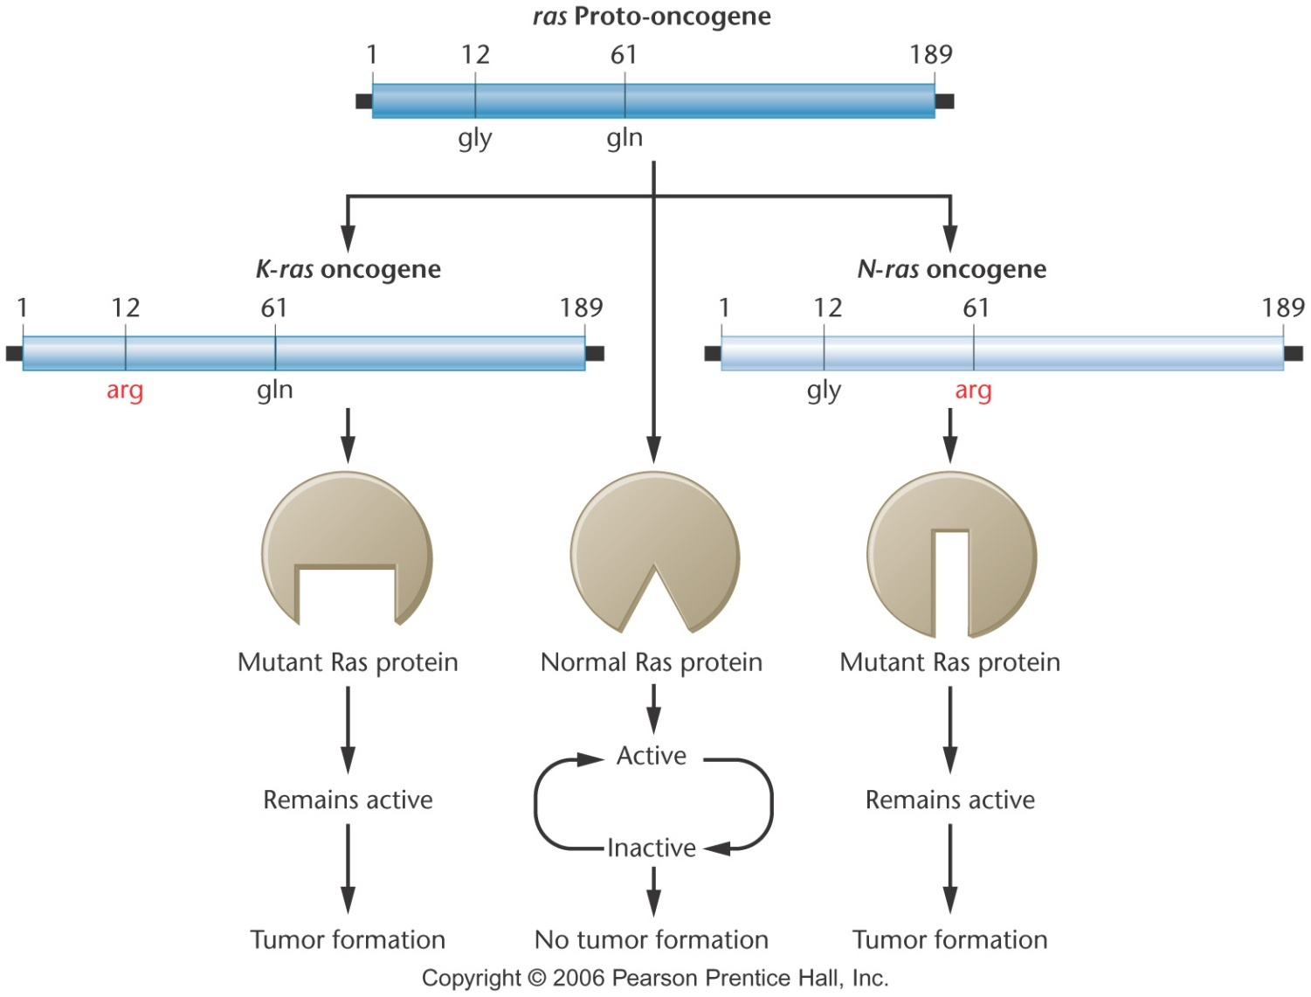
Mutant Ras Protein
Single amino acid changes create N-ras and K-ras variants

Slide 21
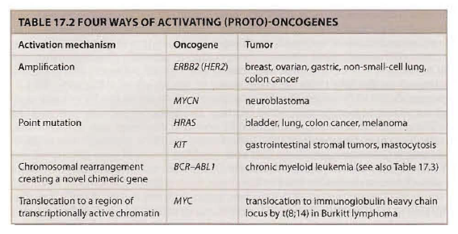

Slide 22
Chromosomal abbreviations

