Slide 1
Addiction 101: The Science of Addiction and The Nature of Recovery and Treatment
Notes:
A basic overview of the nature of addiction and substance abuse
Components of successful recovery and treatment delivery programs.
Major Points:
1. Chemical dependence or addiction is a bona fide disease, there is a science
2. Treatment works, based on science put into practice
3. We are building an accountable system of care
Thanks to:
The National Center for State Courts
under a grant from the State Justice Institute (SJI-01-N-210).

Slide 2
Facts About Addiction & Treatment
WHAT IS ADDICTION?
A BRAIN DISEASE
BUT WITH
BIOLOGICAL, PSYCHOLOGICAL &
SOCIAL COMPONENTS
DOES TREATMENT WORK?
YES, IT IS COST-EFFECTIVE
IN THE LONG RUN
Notes:
Slide Source: Peter Banys, M.D., Assoc. Clinical Prof. of Psychiatry, University of California at San Francisco, VA Medical Center, San Francisco.

Slide 3
Addiction is a Complex Disease (CD is a CD)
…with biological, sociological and psychological components
Notes:
My lecture will discuss what you see on the outside and what is happening inside the person who is chemically dependent.
It is important to realize that CD is a CD.
Image Source: National Institute on Drug Abuse (NIDA) Teaching Packet No. 1: “The Brain & the Actions of Cocaine, Opiates, and Marijuana” http://www.nida.nih.gov/pubs/teaching/Teaching2.html

Slide 4
Case 1
37 year old man, lives with “wife” & 2 children
Inner city, dropped out in 10th grade, skilled worker
Parents are substance users
10 years heroin use IV & intranasal cocaine & alcohol
1 treatment: “detox” 6 years ago
15 years incarcerated since age 15: possession, intent to distribute, armed robbery, 3rd degree sexual offense
Wants help:”I can’t keep living this way”

Slide 5
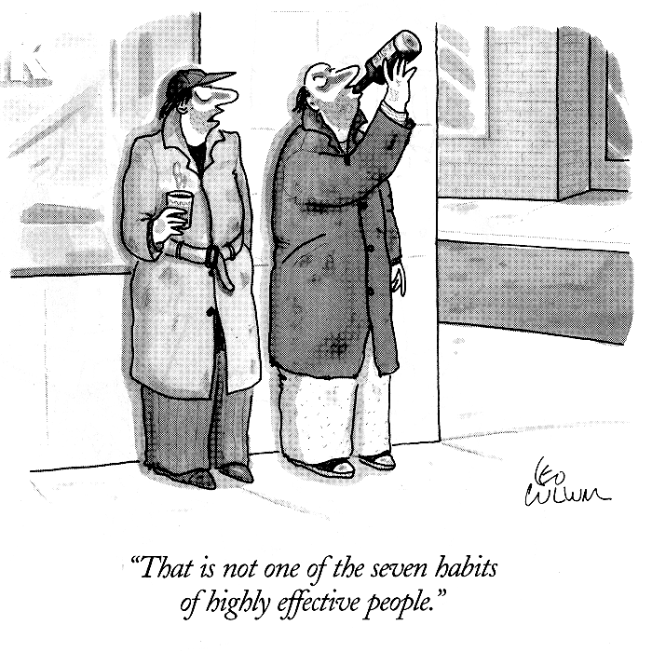
Nature of Substance Abuse
Notes:
What you see on the outside, what the person shows you.
This might make you laugh and/or shake your head
If you haven’t felt angry or offended by the unremitting nature of the chemically abuser
There’s something wrong with you
The clinician can feel these but takes those feelings as clues that the patient is in big trouble with a big disease...
Slide Source: Peter Banys, M.D., Assoc. Clinical Prof. of Psychiatry, University of California at San Francisco, VA Medical Center, San Francisco.

Slide 6
Three “C’s” of Addiction
Control
Early social & recreational use
⇒ Eventual loss of emotional & behavioral control
Cognitive distortions (denial & minimization)
Tolerance & Withdrawal= Strictly defined CD
Compulsion
Drug-seeking activities & Craving ⇒ Addiction
Continued use despite adverse consequences
Chronicity
Natural history of multiple relapses preceding stable recovery
Possible relapse after years of sobriety
Notes:
...who despite consequences, orders to desist and to seek treatment, continues to use. The outside.
Addiction or Chemical Dependence= Abuse + tolerance, craving, withdrawal
Slide Source: Peter Banys, M.D., Assoc. Clinical Prof. of Psychiatry, University of California at San Francisco, VA Medical Center, San Francisco.

Slide 7
Self-Control
Addicts seek control, not abstinence
If I can have justone, then I will be normal, just like my friends
Notes:
Here's what you observe on the surface. What the person shows you. This is the nature of the illness
BUT WHY?
Slide Source: Peter Banys, M.D., Assoc. Clinical Prof. of Psychiatry, University of California at San Francisco, VA Medical Center, San Francisco.

Slide 8
Addiction Risk Factors
Genetics
Earlier Age of Onset
Childhood Trauma (violent, sexual)
Learning Disorders & ADD/ADHD
Mental Illness Predating Use
Depression
Bipolar Disorder
Psychosis
ADHD
Notes:
Why are some people vulnerable to CD while others are not?
Slide Source: “Alcohol and Other Drugs and the Courts” curriculum, Judge Peggy Fulton Hora, Alameda County Superior Court, Hayward, CA and Peter Banys, M.D., Assoc. Clinical Prof. of Psychiatry, University of California at San Francisco, VA Medical Center, San Francisco.

Slide 9
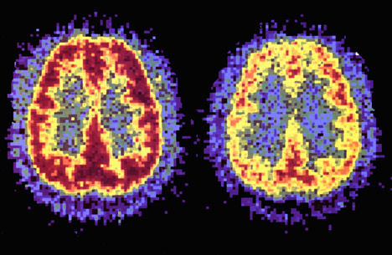
Addiction is a Brain Disease
Prolonged Use Changes
the Brain
in Fundamental and Lasting Ways
“Healthy” Brain
“Cocaine Addict” Brain
Notes:
Positron emission tomography (PET) scan
Person on cocaine, as an example:
Scientists can now see how cocaine actually affects brain function in people.
Cocaine has many actions in the brain incl. activating the reward system.
The PET scan allows us to see how the brain uses glucose. Glucose provides energy to each neuron so it can perform work. The PET scan shows where the cocaine interferes with the brain's use of glucose - or its metabolic activity.
LEFT SCAN: a normal, awake person.
RED COLOR: shows the highest level of glucose utilization (yellow represents less utilization and blue shows the least).
RIGHT SCAN: A cocaine abuser ON cocaine.
Conclusion: Cocaine stops the brain from using glucose effectively
Point out the loss of red compared to the left scan.
There are many areas of the brain that have reduced metabolic activity.
The continued reduction in the neurons' ability to use glucose (energy) results in disruption of many brain functions.
Image Source: National Institute on Drug Abuse (NIDA) Teaching Packet No. 5: “Bringing the Power of Science to Bear on Drug Abuse and Addiction” http://www.nida.nih.gov/pubs/teaching/Teaching5/Teaching3.html
Slide Source: Steve Hanson, MSEd Director, John L. Norris ATC New York State Office of Alcoholism and Substance Abuse Services
Instructions Source: National Institute on Drug Abuse (NIDA) Teaching Packet No. 2: “The Brain & the Actions of Cocaine, Opiates, and Marijuana” http://www.nida.nih.gov/pubs/teaching/Teaching4.html

Slide 10
Notes:
So what are the long-term effects of drug abuse? This PET scan shows us that once addicted to a drug like cocaine, the brain is affected for a long, long time. In other words, once addicted, the brain is literally changed. Here's a different PET scan study.
Less yellow means less normal activity occurring in the brain - even after the cocaine abuser has abstained from the drug for 10 days.
After 100 days without any cocaine, we can see a little more yellow, so there is some improvement - more brain activity - at this point.
But the addict’s brain is still not back to a normal level of functioning... more than 3 months later.
Scientists are concerned that there may be areas in the brain that never fully recover from drug abuse and addiction.
That’s why the addict needs time to recover.
Source: National Institute on Drug Abuse (NIDA) Teaching Packet No. 5: “Bringing the Power of Science to Bear on Drug Abuse and Addiction” http://www.nida.nih.gov/pubs/teaching/Teaching5/Teaching3.html

Slide 11
Questions 1 and 2
1. What are the 3 C’s of Addiction?
2. True or False: “Addicts should only blame themselves for their addiction. They don’t act responsibly.”

Slide 12
How Drugs & Alcohol Work
They interact with nerve circuits, centers, and chemical messengers
Results
I Feel Good – Euphoria & Reward
I Feel “Better” – Reduce negative feelings
This Feels “Normal”
I’m craving it, tolerating its effects,
withdrawing and feeling sick
Notes:
We're looking inside the body and brain.
Slide Source: Steve Hanson, MSEd, Director, John L. Norris ATC, New York State Office of Alcoholism and Substance Abuse Services

Slide 13
Dopamine Spells REWARD
Release
Recycle
Activate
Notes:
Dopamine. Another chemical messenger in the brain. Important in regulating our normal reward and craving systems, also important in understanding psychosis and depression and mania, when the system can go awry. Drugs and alcohol concentrate in areas of the brain that are rich in dopamine synapses.
Top: nerve ending. Bottom: Receptors on the next nerve. In the middle: a gap, called the synapse.
Dopamine gets released in the synapse, activates the next nerve, does it’s job then gets taken in and reprocessed by the nerve ending. A cycle.
So what’s the burgundy? Cocaine. in the synapse, blocks the uptake pumps and prevent them from removing dopamine from the synapse. More dopamine in the synapse, and more dopamine receptors are activated. Leads to changes inside the cell and abnormal firing patterns of the nerves.
The reward system (in the nucleus accumbens) is activated. “Better than sex.” With continued use of drugs (cocaine), the body relies on the drug to maintain rewarding feelings. The person is no longer able to feel the positive reinforcement or pleasurable feelings of natural rewards.
Source: National Institute on Drug Abuse (NIDA) Teaching Packet No. 1: “The Brain & the Actions of Cocaine, Opiates, and Marijuana
http://www.nida.nih.gov/pubs/teaching/Teaching4.html

Slide 14
Natural Rewards
Food
Sex
Excitement
Comfort
Notes:
Natural rewards
If you feel pleasure from these, you want to repeat it. Like go to another Orioles game, because you love the excitement of losing and winning…a lot. These behaviors promote survival of the species. There are pathways in the brain that is responsible for rewarding behaviors.
Source: National Institute on Drug Abuse (NIDA) Teaching Packet No. 2: “The Neurobiology of Drug Addiction”
http://www.nida.nih.gov/Teaching2/Teaching3.html

Slide 15
Brain Reward Pathways
Notes:
A picture of the brain cut down the middle.
I tried to get a volunteer, but no one signed up?
This is one of the major reward pathways. VTA releases dopamine in the nucleus accumbens where feel rewarded and the prefrontal cortex where you KNOW you are rewarded and what rewarded you.
Source: National Institute on Drug Abuse (NIDA) Teaching Packet No. 2: “The Neurobiology of Drug Addiction” http://www.nida.nih.gov/Teaching2/Teaching3.html

Slide 16
Activation of Reward
Notes:
IN Summary: addictive drugs, and EtOH activate the reward system via increasing dopamine neurotransmission. Here’s the places where some of these substances act.
Heroin: VTA and NA
Cocaine and Nicotine: NA
Alcohol: indirectly in the globus pallidus, which connects to the NA. Pardon me sir, is this the VTA-NA choo-choo? On track 29, all you need is a dime. 29th injection of 10 dollars worth of heroin.
Because of the way our brains are designed,
because these drugs activate this particular brain pathway for reward,
they have the ability to be abused.
Thus, addiction is truly a disease of the brain.
As scientists learn more about this disease,
they may help to find an effective treatment strategy for the recovering addict.
Here’s some clues:
Stop them from getting there: vaccines, block the nerve ending
Stop yourself from using: use your cortex in treatment and use support to get pleasure from
Recovering peopble
Counseling and medications and support systems
Source: National Institute on Drug Abuse (NIDA) Teaching Packet No. 2: “The Neurobiology of Drug Addiction” http://www.nida.nih.gov/Teaching2/Teaching5.html

Slide 17
Behavior Pathways
A rewarding behavior becomes routine
⇓
“Subconscious” control of the behavior
⇓
It is hard to extinguish the behavior:
I am not always aware when it is starts
⇓
The person resists change
⇓
It is a Habit
Notes:
From the inside to the outside.
But they keep using. Why? The brain is hijacked.
Slide Source: Steve Hanson, MSEd, Director, John L. Norris ATC, New York State Office of Alcoholism and Substance Abuse Services

Slide 18
Addiction = Dog with a Bone
It never wants to let go.
It bugs you until it gets what it wants.
It never forgets when and where it is used to getting its bone.
It thinks it’s going to get a bone anytime you do anything that reminds it of the bone.
Notes:
It’s like a dog with a bone. Like my dog Harry.
Holland Tunnel
Slide Source: Steve Hanson, MSEd, Director, John L. Norris ATC, New York State Office of Alcoholism and Substance Abuse Services

Slide 19
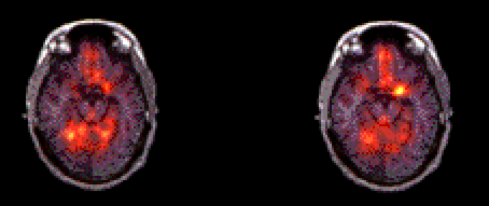
How Long Does the Brain Remember?
Amygdala is not lit up
Amygdala is activated
Front of Brain
Back of Brain
Nature Video
Cocaine Video
Notes:
You know this song?
You go to my head and you linger like a haunting refrain
And I find you spinning 'round in my brain
Like the bubbles in a glass of champagne
You go to my head like a sip of sparkling Burgundy brew
And I find the very mention of you
Like the kicker in a julep or two
Haven Gillespie, J. Fred Coots
The memory of drugs - just the mention of items associated with drug use may cause an addict to “crave” or desire drugs.
PET scan
recovering addicts, who had stopped using cocaine, compared with
people who had no history of cocaine use to determine what parts of the brain are activated when drugs are craved.
watched two videos.
a nondrug presentation, showed nature images - mountains, rivers, animals, flowers, trees.
cocaine and drug paraphernalia, such as pipes, needles, matches, and other items familiar to addicts.
The yellow area amygdala (a-mig-duh-luh), a part of the brain’s limbic system, which is critical for memory and responsible for evoking emotions. For an addict, when a drug craving occurs, the amygdala becomes active, and a craving for cocaine is triggered. GOLF
This craving demands the drug immediately.
The uncontrollable desire for drugs overruns and tramples over rational thinking.
A basic change has occurred in the brain.
This changed brain makes it almost impossible for drug addicts to stay drug-free
without professional help.
Source: National Institute on Drug Abuse (NIDA) Teaching Packet No. 5: “Bringing the Power of Science to Bear on Drug Abuse and Addiction” http://www.nida.nih.gov/pubs/teaching/Teaching5/Teaching4.html

Slide 20
Cognitive Deficits and D&A
Memory problems – short-term loss
Impaired abstraction
Perseveration using failed problem-solving strategies
Loss of impulse control
These deficits are similar to
those with brain damage
Notes:
On the outside: Thinking deficits aplenty
Slide Source: Steve Hanson, MSEd, Director, John L. Norris ATC, New York State Office of Alcoholism and Substance Abuse Services and Peter Banys, M.D., Assoc. Clinical Prof. of Psychiatry, University of California at San Francisco, VA Medical Center, San Francisco.

Slide 21
Question 3
3. What is it that makes addicted people like drugs and alcohol so much?

Slide 22
Commonly Abused Drugs
Alcohol
Class of Drug:
Sedatives-Hypnotics
Related Issues:
Detoxification
Fetal Alcohol Syndrome (FAS)
Loss of Judgment
Suicide/Homicide
DWI/DUI Concerns
Poly-drug Use
Legality Issues
Notes:
Here are the most prominent unique characteristics of addiction found for particular drugs
These could occur while using, when stopped using, or need to be considered with treatment
They have particular implications for the behavior and accountability expectations of court participants addicted to these drugs.
The issues raise considerations for the issuance of orders by the court and the judicial process.
The following are some ideas about how to relate the issues to the judicial process or special issues about which judges should be aware:
Detoxification - Alcohol withdrawal is severe and can be life threatening. Supervision during detox is recommended.
Fetal Alcohol Syndrome (FAS) – If a court participant is pregnant, there is special concern for the fetus to be born intact and healthy.
Loss of Judgment – Alcoholics exhibit significant loss of judgment, particularly when using. Judges need to consider this element of the addiction in crafting orders.
Suicide/Homicide Rates with Intoxication – The higher prevalence of aggression, as well as suicide attempts, should be considered.
DWI and DUI concerns – The public safety hazards associated with alcohol abuse are significant.
Poly-drug Use – Alcohol is often abused in conjunction with other substances (you can refer back to the slide in Module 1 (Slide 10) that shows that 20.2% of addicts admitted to treatment were abusing alcohol AND another drug.
Legality Issues – Our society tends to normalize excessive drinking because alcohol is a legal substance. Therefore, many will underplay the significance of the problem of alcoholism.
Medications Available – In terms of treatment options, medications to assist in treating alcoholism are available (e.g., Antabuse and Naltrexone).
Source: Adapted from John N. Marr, MS, Presentation on “Basic Pharmacology – Addiction: Fact versus Fiction” for the National Drug Court Institute.

Slide 23
Commonly Abused Drugs
Marijuana
Class of Drug:
Hallucinogens
Related Issues:
Lack of Motivation
Arrested Development
Memory & Learning
Problems
Long Detection Time
Legalization Issues
Medical Use Issues
Health Issues
Notes:
Higher potency today than in the 60s – considered 10x stronger or more.
Amotivational syndrome –Counterproductive to compliance/knocks out drive and ambition.
Arrested development – Abusers are likely to have low emotional maturity – the drug causes the user’s emotional maturity to stop developing (generally considered as of time in terms of chronological age when they began “using”) so even though the court participant is 30, he or she may be acting as though he or she is 17.
Memory/Learning Problems – These effects will make it difficult for participants to remember compliance issues (such as attending group sessions).
Long detection time in urine – Although many alteration methods are available to “fake” a clean urine screen, alternative testing – such as hair testing – can also be used because marijuana has a long half-life in the body.
Legalization – The push to legalize marijuana may undermine compliance issues.
Medical Use Issues – Although claims about the medical uses of marijuana are prevalent, its only medically confirmed uses are for cancer chemotherapy nausea and AIDS Wasting Syndrome anorexia.
Health Issues – Marijuana joints are highly carcinogenic (they have 5-7 Times more tar than cigarettes).
Source: Adapted from John N. Marr, MS, Presentation on “Basic Pharmacology – Addiction: Fact versus Fiction” for the National Drug Court Institute.

Slide 24
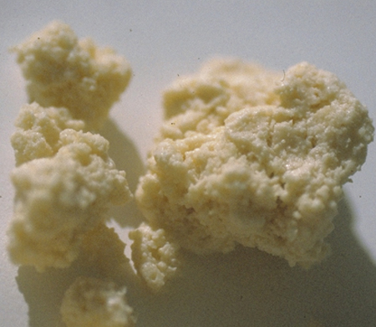
Commonly Abused Drugs
Cocaine/Crack
Class of Drug:
Stimulants
Related Issues:
High-relapse Potential
High Reward
A Cycle: Euphoria ⇒ Agitation ⇒ Paranoia ⇒ “Crash” ⇒ Sleeping ⇒ Euthymia ⇒ Craving ⇒
Obsessive Rituals
Risk of Permanent Paranoia
No Medications Currently Available
Notes:
High-relapse potential – You should never be surprised by relapse, it is to be expected, especially early in treatment. The most severe and rampantly addictive substance.
High Reward – Part of the relapse issue is the significant stimulation of the brain reward zones when using cocaine. (Rats will do work - press levers - for cocaine, preferred over sex, until they die of exhaustion.)
Euphoria - Agitation – Paranoia - “Crash” – Sleep – Craving – Progression of use
Obsessive Rituals – Cocaine addiction is characterized by rituals that trigger use (e.g., getting money from an ATM, seeing white powder). Finding a means to break the triggers is critical to treatment. Holland tunnel phenomenon.
Risk of permanent paranoia – You should be aware of a risk among former cocaine abusers of a permanent “kindling” of paranoia and hallucinations even after use has stopped.
No medications are currently available – although tests are being conducted on some new meds.
Source: Adapted from John N. Marr, MS, Presentation on “Basic Pharmacology – Addiction: Fact versus Fiction” for the National Drug Court Institute. Also content from Peter Banys, M.D., Assoc. Clinical Prof. of Psychiatry, University of California at San Francisco, VA Medical Center, San Francisco.

Slide 25
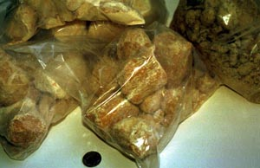
Commonly Abused Drugs
Methamphetamines
Class of Drug:
Stimulants
Related Issues:
High Energy Level
Repetitive Behavior Patterns
Incoherent Thoughts and Confusion
Auditory Hallucinations and Paranoia
Binge Behavior
Long-acting (up to 12 hours)
Notes:
Like long-lasting cocaine, methamphetamines destroys certain nerve tissue and are more debilitating to the brain than cocaine – it’s man-made - common terms: speed, meth, chalk, ice, crystal. It’s sweeping in from the West.
High energy level – Even small doses can lead to increased wakefulness, physical activity and decreased appetite.
Repetitive behavior patterns – These are similar to compulsive disorders, such as picking at skin/pulling out hair.
Incoherent thoughts/Confusion
Auditory hallucinations/paranoia – In extreme cases, the paranoia can result in homicidal and suicidal thoughts (also common: formication – delusions of parasites or insects on skin).
Binge behavior – Because pleasurable effects disappear even before the drug concentration in the blood falls significantly, users try to maintain the high by binging on the drug.
Long-acting (up to 12 hours): Because it is so long-lasting, it is harder to control effects.
Source: Adapted from John N. Marr, MS, Presentation on “Basic Pharmacology – Addiction: Fact versus Fiction” for the National Drug Court Institute.

Slide 26
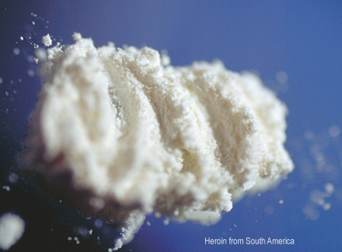
Commonly Abused Drugs
Heroin
Class of Drug:
Opiates
Related Issues:
Detoxification
Medications Available
Euphoria
Craving
Intense Withdrawal
Physical Pain
Notes:
FACULTY NOTE:
New production (in South America) with high purity and potency.
More recently a smokeable form has been created. And a serious increase in pain drug abuse, such as Oxycontin.
Detoxification - It has limited long-term efficacy because of the strong psychological AND physical addiction.
Medications available – Methodone maintenance is more effective for most users (not psychologically, but it seems to work better).
Euphoria – initial surge of euphoria (“rush”) immediately after injection; enters brain very rapidly, so particularly addictive. After rush, period of drowsiness (several hours).
Craving – This will affect relapse and ability to comply with treatment.
Intense withdrawal – This can occur within just a few hours of the last time the drug is taken, and peak 2-4 days after last use.
Physical pain – Opiates are unlike other drugs in that withdrawal is accompanied by great physical pain.
Source: Adapted from John N. Marr, MS, Presentation on “Basic Pharmacology – Addiction: Fact versus Fiction” for the National Drug Court Institute.

Slide 27
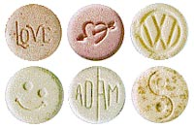
Commonly Abused Drugs
“New Drugs”
Club Drugs
Prescription Drugs
Popular with Youth and Young Adults
Significant Health Risks: Neuron Destruction with
Ecstasy
Users Believe They Know How to Reduce the Risks –
WRONG!
Use increasing for Oxycontin, decreasing for Ecstasy
Notes:
FACULTY NOTE:
Types: Ecstasy (MDMA); GHB (Gamma Hydroxy Butyrate); Rohypnol (related to Valium)
Source: Adapted from John N. Marr, MS, Presentation on “Basic Pharmacology – Addiction: Fact versus Fiction” for the National Drug Court Institute. Also content from Peter Banys, M.D., Assoc. Clinical Prof. of Psychiatry, University of California at San Francisco, VA Medical Center, San Francisco.

Slide 28
Common Characteristics of People Who are Addicted
Unemployed or employed
Multiple or no criminal justice contacts
Difficulty coping with stress or anger
Highly influenced by social peer group or a loner
Difficulty handling high-risk relapse situations or craves excitement
Notes:
The biological and psychological effects of these substances result in societal disorder. outside
Slide Source: “Responding to Substance Abuse: The Role We All Play,” The Substance Abuse Leadership Team (SALT) of the Franklin County Courts Conference, SAMSHA Grant No. 4U98 T100 846 and Peter Banys, M.D., Assoc. Clinical Prof. of Psychiatry, University of California at San Francisco, VA Medical Center, San Francisco.

Slide 29
More Common Characteristics…
Emotional and psychological immaturity
Difficulty relating to family
Difficulty sustaining long-term relationships
Educational and vocational deficits
Notes:
And lead to immaturity, poor relatedness, and incompetency.

Slide 30
Violence
Alcohol disinhibits aggressivity
Stimulants produce dose-dependent paranoia
Opiate-seeking, but not opiates, produces violence
Notes:
And violence under the influence or when withdrawing.
Slide Source: Peter Banys, M.D., Assoc. Clinical Prof. of Psychiatry, University of California at San Francisco, VA Medical Center, San Francisco.

Slide 31
What Are The Risks Of Becoming Addicted?
Genetic predisposition
A younger age for beginning use
Childhood trauma (violent, sexual)
Learning disorders &/or ADD/ADHD
Mental illness
Depression
Bipolar disorder
Psychosis
Personality disorder

Slide 32
Questions 4, 5, and 6
What are the 1st and 2nd most craved substances?
What are the 1st, 2nd and 3rd most used substances?
True or False: Addicted people are usually homeless, criminal, anti-social, and older than 26.

Slide 33
Co-Occurring Disorders
Each Disorder Affects the Other
And
Changes The Outcome Of Treatment

Slide 34
Case 2
25 year old single woman pregnant with one child
GED, wants to go to community college
Opiate, nicotine, alcohol dependent
Depression & anxiety since age 20
1 suicidal attempt
Multiple intense & brief relationships
CWS involved: neglect
Close to parents, no female friends

Slide 35
Multiaxial Diagnoses
Axis I | Clinical Disorders
Axis II | Personality Disorders & Mental Retardation
Axis III | Medical Conditions
Axis IV | Psychosocial Factors
Axis V | Global Assessment of Functioning (GAF)

Slide 36
IF TEENS ABUSE SPECIFIC SUBSTANCES, WHAT’S THEIR RISK OF HAVING MENTAL HEALTH PROBLEMS?
(2004, ADAA-FUNDED, N=2957, POSIT)

Slide 37
IF TEENS ABUSE COCAINE, WHAT’S THEIR RISK OF HAVING MENTAL HEALTH PROBLEMS?
(2004, ADAA-FUNDED, N=120, POSIT)

Slide 38
IF TEENS ABUSE OPIATES, WHAT’S
THEIR RISK OF HAVING MENTAL HEALTH PROBLEMS?
(2004, ADAA FUNDED, N=148)

Slide 39
Why Do We Need to Do More to Help People with Co-Occurring Disorders?
More treatment failures & cost
More relapse
More re-hospitalization
More ER visits
More vulnerability: violence, suicide, homelessness, arrests
More illness and earlier deaths
More resistance to treatment
Notes:
Slide source: Eastman & Fawcett: Prin and Pract of Addiction Psychiatry, p407, 1997.
Morbidity: illness & disability

Slide 40
Co-Occurring Disorders = COD
Mood Disorder+: 24-40% have a co-occurring substance abuse disorder
Alcoholism+: 65% of females and 44% of male alcoholics have co-occurring mental health disorder(s)
THE MAJOR ONE = DEPRESSION 19% of female alcoholics, 4x the rate for men
Notes:
To complicate the problem. Having a co-existing disorder leads to increased substance abuse and vice versa. In 2003, about 22 % of adults with substance abuse or dependence had a serious mental illness. That’s 4.2 million adults. Of those without SA or CD, 8% had SMI.
And don’t forget the physical effects of chemicals, on the brain and on the body. A downward spiral.
Slide Source: “Alcohol and Other Drugs and the Courts” curriculum, Judge Peggy Fulton Hora, Alameda County Superior Court, Hayward, CA.

Slide 41
Co-Occurring Disorders = COD
Addiction+: 30-59% of women in treatment have PTSD, 2-3 times the rate for men
Prescriptions: 1:7 women >64 years old take medication for a mental health disorder
Don’t Forget Physical Effects: body/brain breakdown
Notes:
To complicate the problem. Having a co-existing disorder leads to increased substance abuse and vice versa. In 2003, about 22 % of adults with substance abuse or dependence had a serious mental illness. That’s 4.2 million adults. Of those without SA or CD, 8% had SMI.
And don’t forget the physical effects of chemicals, on the brain and on the body. A downward spiral.
Slide Source: “Alcohol and Other Drugs and the Courts” curriculum, Judge Peggy Fulton Hora, Alameda County Superior Court, Hayward, CA.

Slide 42
Questions 7 and 8
True or False: most addicted people have co-occurring disorders.
True or False: the social and clinical outcomes for people with co-occurring disorders is worse than for those with primary substance abuse or addiction.

Slide 43
TREATMENT WORKS

Slide 44
How Can We Enable Recovery?
Education
Curiosity
Setting reasonable and legal limits
Patience
Humility
Organizing a system of care
Avoid scapegoating and stigmatization

Slide 45
Thanks to David R. McDuff 2005

Slide 46
Thanks to David R. McDuff 2005

Slide 47
Thanks to David R. McDuff 2005

Slide 48
To Recover Or Discover?
A process of growing
Accepting the illness
Making healthy choices about treatment and living in the world
Being motivated and hopeful
Notes:
Minkoff: Prin and Pract Addiction Psychiatry, p191, 1997.

Slide 49
What is Recovered in Recovery ?
Abstinence
Sense of Responsibility
Range of Emotions
Intimacy
Notes:
There is hope.
Slide Source: Peter Banys, M.D., Assoc. Clinical Prof. of Psychiatry, University of California at San Francisco, VA Medical Center, San Francisco.

Slide 50
Abstinence and Sobriety
Abstinence
Stopping Alcohol Or Illicit Substance Abuse For A Period Of Time
●
Sobriety
A Lifestyle Based On Treatment
And Personal Change
Notes:
Slide Source: Peter Banys, M.D., Assoc. Clinical Prof. of Psychiatry, University of California at San Francisco, VA Medical Center, San Francisco.

Slide 51
Phases of Recovery
Crisis
Stability and Structure
Consistency and Balance
Attachment and Intimacy
Notes:
Here’s the stages a person goes through in recovery.
A process not an end state. We therefore need to develop supporting institutions and a mindframe to manage the person at any state of their disease at any setting. Most of whom you will see in court are still in the crisis stage.
Slide Source: Peter Banys, M.D., Assoc. Clinical Prof. of Psychiatry, University of California at San Francisco, VA Medical Center, San Francisco.

Slide 52
What Complicates Recovery?
Socio-economic
Single parent
Ethnic
Matriarch/ Patriarch
Gender
Religion
Treatment method
Co-dependency
Employment
Domestic violence
Living situation
Extended family
Notes:
There are many issues to be managed in helping the person in recovery. Help means determining what is most important to work on first so as to help the person recover without becoming too overwhelmed, which would lead to relapse. We are dealing with the walking wounded.
Slide Source: John N. Marr, MS, Presentation on “Basic Pharmacology – Addiction: Fact versus Fiction” for the National Drug Court Institute.

Slide 53
Question 10
Which is not true?
Professionals need a timeline to help plan someone’s recovery
Most people who are in treatment are in the crisis stage
People with sobriety are usually abstinent
Recovery is a process, not a goal

Slide 54
Who needs treatment?
13 to 16 million Americans need treatment for alcohol and/or other drug abuse in any year
BUT…
Only 3 million receive care
Notes:
Slide Source: “Changing the Conversation,” Improving Substance Abuse Treatment: The National Treatment Plan Initiative, DHHS Pub. No. (SMA)00-3480 (2000) http://www.natxplan.org/news/vol2.pdf

Slide 55
In Maryland FY2005
~ 290,000 Maryland adults need alcohol or drug treatment vs. 76,538 admissions to treatment (~26%)
Young adults 18 to 25 have the highest unmet need for alcohol and drug treatment in the state
Estimated Costs Per Year
Alcohol abuse > $3 billion
Illicit drug abuse > $2 billion

Slide 56
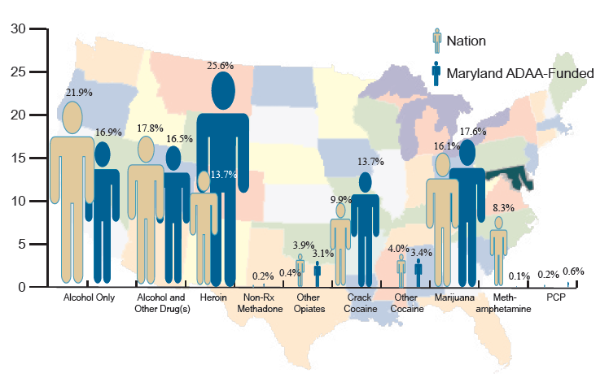

Slide 57
This is a Public Health Problem
Drug & alcohol treatment is disease prevention
HIV infection in injecting drug users: 6x greater without treatment
>90% injection drug users are infected with Hepatitis C virus
Why Not Harm Avoidance?
Notes:
We need to provide help from a public healthl perspective alone.
HIV/AIDS, Hepatitis and Other Infectious Diseases
Drug injectors who do not enter treatment are up to 6 times more likely to become infected with HIV than injectors who enter and remain in treatment.
Drug users who enter and continue in treatment reduce activities that can spread disease,
such as sharing injection equipment and engaging in unprotected sexual activity.
Participation in treatment also presents opportunities for screening, counseling, and referral for additional services.
The best drug abuse treatment programs provide HIV counseling and offer HIV testing to their patients.
Slide Source: National Institute on Drug Abuse (NIDA) Teaching Packet No. 3: “Understanding Substance Abuse and Addiction: What Science Says” http://www.nida.nih.gov/pubs/teaching/Teaching3/Teaching5.html and Peter Banys, M.D., Assoc. Clinical Prof. of Psychiatry, University of California at San Francisco, VA Medical Center, San Francisco.

Slide 58
Matching Treatment with the Individual’s Needs
No single treatment is appropriate for all individuals
Effective treatment attends to multiple needs of the individual, not just his or her drug use
Treatment must address medical, psychological, social, vocational, and legal problems =
MULTI-SYSTEMIC AND MULTI-MODAL
Notes:
No single treatment is appropriate for all individuals. Matching treatment setting, interventions, and services to each individual's particular problems and needs is critical to his or her ultimate success in returning to productive functioning in the family, workplace, and society. We use the ASAM criteria to determine the appropriate level of care. HOLD UP THE BOOK.
Effective treatment attends to multiple needs of the individual, not just his or her drug use. To be effective, treatment must address the individual's drug use and any associated medical, psychological, social, vocational, and legal problems.
Image Source: National Institute on Drug Abuse (NIDA) Teaching Packet No. 3: “Understanding Substance Abuse and Addiction: What Science Says” http://www.nida.nih.gov/pubs/teaching/Teaching3/Teaching4.html

Slide 59
Choose The Level of Care
ASAM
Patient Placement Criteria 2nd Edition
PPC-2

Slide 60
ASAM CRITERIA (AMERICAN SOCIETY OF ADDICTION MEDICINE)
DEVELOPED OVER 17 YEARS
ADMISSION, CONTINUED SERVICE AND DISCHARGE CRITERIA
SEPARATE CRITERIA FOR ADOLESCENTS AND FOR ADULTS
DETOXIFICATION SERVICES ARE CONSIDERED AT EACH LEVEL OF CARE

Slide 61
ASAM CRITERIA (AMERICAN SOCIETY OF ADDICTION MEDICINE)
FIRST: Assess Six Dimensions
Acute Intoxication and/or Withdrawal Potential
Biomedical Conditions
Emotional/Behavioral Conditions & Complications
Treatment Acceptance/Resistance
Relapse/Continued Use Potential
Recovery/Living Environment

Slide 62
ASAM CRITERIA (AMERICAN SOCIETY OF ADDICTION MEDICINE)
SECOND: Choose the Level of Care
Early intervention
Outpatient Treatment
Intensive outpatient or partial hospitalization
Residential/Inpatient Treatment: 4 sublevels
Medically Managed Intensive Inpatient Treatment
Opioid Maintenance Therapy

Slide 63
ASAM CRITERIA (AMERICAN SOCIETY OF ADDICTION MEDICINE)
ASAM DEFINES THE CHARACTERISTICS
OF EACH LEVEL PROGRAM BY
EXAMPLES OF PROGRAM TYPES
SETTING (Location)
SUPPORT SYSTEMS
STAFF NEEDED
THERAPIES OFFERED
ASSESSMENT AND TREATMENT PLAN REVIEW
DOCUMENTATION REQUIRED
ADMISSION, CONTINUED SERVICE AND DISCHARGE CRITERIA

Slide 64
What Next?
THIRD: Create a Treatment Plan
Goals
Treatment priorities
Types of counseling & education
Detoxification
Treatment priorities
Recovery supports, including self-help groups
Coercion

Slide 65
Coercion
Treatment does not need to be voluntary to be effective
Court-Ordered Probation
Family Pressure
Employer Sanctions
Medical Consequences
Notes:
Treatment does not need to be voluntary to be effective.
Strong motivation can facilitate the treatment process.
Sanctions
Enticements in the family
Employment setting
Criminal justice system
Can increase significantly
Treatment entry rates
Retention rates
The success of drug treatment interventions
Individuals who enter treatment under legal pressure
have outcomes as favorable as those who enter treatment voluntarily.
Slide Source: National Institute on Drug Abuse (NIDA) Teaching Packet No. 3: “Understanding Substance Abuse and Addiction: What Science Says” http://www.nida.nih.gov/pubs/teaching/Teaching3/Teaching5.html and Peter Banys, M.D., Assoc. Clinical Prof. of Psychiatry, University of California at San Francisco, VA Medical Center, San Francisco.

Slide 66
Self Help
Complements and extends treatment efforts, but it is not treatment
Most commonly used models include 12-Step (AA, NA) models
Most treatment programs encourage self-help participation during/after treatment
Notes:
Slide Source: National Institute on Drug Abuse (NIDA) Teaching Packet No. 3: “Understanding Substance Abuse and Addiction: What Science Says” http://www.nida.nih.gov/pubs/teaching/Teaching3/Teaching5.html

Slide 67
12-Step Groups
Myths
Only AA can treat alcoholics
Only a recovering individual can treat an addict
12-step groups are intolerant of prescription medication
Groups are more effective than individual support because of confrontation
Notes:
Not true
Slide Source: Peter Banys, M.D., Assoc. Clinical Prof. of Psychiatry, University of California at San Francisco, VA Medical Center, San Francisco.

Slide 68
12-Step Groups
Facts
Available 7 days/week, 24 hrs/day
Work well with professionals
Primary treatment modality is fellowship (identification)
Safety and acceptance predominate over confrontation
They offer a safe environment to develop intimacy
Notes:
Here’s the facts
Slide Source: Peter Banys, M.D., Assoc. Clinical Prof. of Psychiatry, University of California at San Francisco, VA Medical Center, San Francisco.

Slide 69
Counseling and Other Behavioral Therapies
Drug Resisting Skills
Problem-solving Skills
Replacing
Drug Using
Activities
Replace
Drug Using
Activities
Building Interpersonal Relationships
Motivational
Enhancement
Counseling
Notes:
Counseling and Other Behavioral Therapies
These are critical components of effective treatment for addiction.
In therapy, patients
address motivational issues,
build skills to resist drug use
replace drug-using activities with constructive and rewarding nondrug-using activities
improve problem-solving abilities.
Behavioral therapy also facilitates interpersonal relationships and the individual’s ability to function in the family and community.
Image Source: National Institute on Drug Abuse (NIDA) Teaching Packet No. 3: “Understanding Substance Abuse and Addiction: What Science Says” http://www.nida.nih.gov/pubs/teaching/Teaching3/Teaching4.html

Slide 70
Medical Detoxification
Medical detoxification is only the first stage of addiction treatment
By itself, it does little to change long-term drug and alcohol use
There are high post-detoxification relapse rates
Detoxification is not a cure!
It prepares the person for further care
Notes:
Medical Detoxification
Medical detoxification safely manages the acute physical symptoms of withdrawal associated with stopping drug use. However, medical detoxification is only the first stage of addiction treatment and by itself does little to change long-term drug use. While detoxification alone is rarely sufficient to help addicts achieve long-term abstinence, for some individuals it is a strongly indicated precursor to effective drug addiction treatment.
Slide Source: National Institute on Drug Abuse (NIDA) Teaching Packet No. 3: “Understanding Substance Abuse and Addiction: What Science Says” http://www.nida.nih.gov/pubs/teaching/Teaching3/Teaching4.html and Peter Banys, M.D., Assoc. Clinical Prof. of Psychiatry, University of California at San Francisco, VA Medical Center, San Francisco.

Slide 71
Medications
Medications are an important element of treatment for many patients, especially when combined with counseling and other behavioral therapies.
Alcohol: Naltrexone (oral and injectable), Disulfiram, Acamprosate
Opiates: Naltrexone, Methadone, ````````````Buprenorphine
Nicotine: Nicotine replacement (gum, patches, spray, inhaler), Bupropion, Varenicline
Stimulants: [None to date]
Notes:
Slide Source: National Institute on Drug Abuse (NIDA) Teaching Packet No. 3: “Understanding Substance Abuse and Addiction: What Science Says” http://www.nida.nih.gov/pubs/teaching/Teaching3/Teaching5.html and Peter Banys, M.D., Assoc. Clinical Prof. of Psychiatry, University of California at San Francisco, VA Medical Center, San Francisco.

Slide 72
When Should We Suggest Medications?
“Nothing works”: Psychosocial interventions are not effective for abstinence or reduced drinking
“I’ve got to stop”: An immediate serious need to stop or reduce drinking
“Just help me stop”: The patient wants to stop or reduce drinking but not interested or able to start counseling or self-help
“Thanks for the meds. I’ll get it under control”: Unable to accept the idea of a chronic disease

Slide 73
Why Recommend a Medication?
Reduced drinking leads to abstinence
Helps the motivated person stay abstinent when severe consequences for relapse
Allows for time to
Learn coping skills
Build a social network
Re-establish intimate relationships

Slide 74
Why Don’t People Take Medications Regularly?
Poor Adherence Because
Medication “doesn’t seem to work”
Irrational worries about side effects and safety
Side effects, especially early onset
Complicated or frequent dosing
Relapses: unintentional forgetting, reduced motivation
Expense
Believes that AA and NA discourage medications: not true

Slide 75
Myths of Addiction Treatment
Myth of Self-Medication
Treating just the “underlying” disorders tends not to work
Depression doesn’t make you drink
Drugs do make you feel good at first
But you feel less and less good and feel worse and more over time
“I Was Medicating My Disease”
“I Wasn’t Medicating My Problems…”
“They Only Got Worse”
Notes:
Slide Source: Peter Banys, M.D., Assoc. Clinical Prof. of Psychiatry, University of California at San Francisco, VA Medical Center, San Francisco.

Slide 76
Myths of Addiction Treatment
Myth of Self-Medication
Myth of Character Weakness
Weakness or will power has little to do with becoming addicted
Even the “educated and strong” from all walks of life succumb to drugs and alcohol
Notes:
Slide Source: Peter Banys, M.D., Assoc. Clinical Prof. of Psychiatry, University of California at San Francisco, VA Medical Center, San Francisco.

Slide 77
Myths of Addiction Treatment
Myth of Self-Medication
Myth of Character Weakness
Myth of Holding One’s Liquor
The “Wooden Leg” Syndrome
IT DOES NOT PREDICT IMMUNITY TO ALCOHOLISM
IT PREDICTS ALCOHOLISM
Notes:
Slide Source: Peter Banys, M.D., Assoc. Clinical Prof. of Psychiatry, University of California at San Francisco, VA Medical Center, San Francisco.

Slide 78
Myths of Addiction Treatment
Myth of Self-Medication
Myth of Character Weakness
Myth of Holding One’s Liquor
Myth of Detoxification
Becoming abstinent is easy
Staying sober is incredibly difficult
Notes:
Slide Source: Peter Banys, M.D., Assoc. Clinical Prof. of Psychiatry, University of California at San Francisco, VA Medical Center, San Francisco.

Slide 79
Myths of Addiction Treatment
Myth of Self-Medication
Myth of Character Weakness
Myth of Holding One’s Liquor
Myth of Detoxification
Myth of Brain Reversibility
Addiction produces permanent neurotransmitter and chemical changes
“Kindling” increases risk of permanent paranoia, hallucinations (from alcohol and stimulants), and emotional explosiveness
Notes:
Slide Source: Peter Banys, M.D., Assoc. Clinical Prof. of Psychiatry, University of California at San Francisco, VA Medical Center, San Francisco.

Slide 80
Myths of Addiction Treatment
Myth of Self-Medication
Myth of Character Weakness
Myth of Holding One’s Liquor
Myth of Detoxification
Myth of Brain Reversibility
Myth of Purification and Perfection
Notes:
Slide Source: Peter Banys, M.D., Assoc. Clinical Prof. of Psychiatry, University of California at San Francisco, VA Medical Center, San Francisco.

Slide 81
The Myth of Purification and Perfection
Five Myth-Conceptions
Recovery means “detoxification”
Purification is a means not an end
Recovery as a developmental process is irrelevant
Scientific research and the science of addiction has no bearing
Drug-free treatment means NO opioid maintenance no matter how many relapses. You don’t treat addiction with an addicting drug

Slide 82
Question 11
True or False:
Alcoholics can be taught to hold their liquor
Even if addicts learn that they are self-medicating, they still won’t stop using
The brain can get back to normal if one is recovering over time
Most opiate addicts don’t need to be on methadone
My alcoholic father has no will to stop

Slide 83
Let Facts & Humility Get in the Way of Ideology & Unfounded Theory
Craving and relapse represent how the brain has a stubborn switch that is stuck
The potential for relapse is lifelong
Opiate cravings are lifelong and vary in intensity over time
People respectfully treated at their stage of development do better
When cravings interfere with treatment, strategic treatment with OMT brings better outcomes
Patients on OMT who look impaired need medical and treatment attention

Slide 84
So…
Treatment must be medically & scientifically driven: “Show me the research!”
“Drug-free” treatment is appropriate at a specific developmental stages of recovery for some, but not all, patients
Condemning patients who are OMT patients is stigmatizing and does not promote recovery
There is no debate…let’s respect the humanness of people suffering and treat them
…Cut the person a break

Slide 85
TREATMENT IS COST-EFFECTIVE
Notes:
Slide Source: Peter Banys, M.D., Assoc. Clinical Prof. of Psychiatry, University of California at San Francisco, VA Medical Center, San Francisco.

Slide 86
What The Treatment Community Needs to Do: Long-Term Goals
Foster a Learning Culture
Be Organized
Be Predictable
Measure Outcomes
Communicate with Other Agencies
Base Treatment on Evidence and A Manualized Approach
Integrate Services

Slide 87
Choose a Manual

Slide 88
Keep Fidelity to a Model of Treatment

Slide 89
The Six C’s of COD: Making Treatment Work
Combine
Compute
Crosstrain
Care
Compensate
Collaborate

Slide 90
Treatment Effectiveness
Drug dependent people who participate in drug treatment
⇓ Drug use
⇓ Criminal activity
⇑ Employment
⇑ Social and intrapersonal functioning
⇑ Physical health
Drug Use & Criminal Activity
⇓⇓ For virtually all who enter treatment ⇒
⇑⇑ results the longer they stay in treatment
Notes:
RESEARCH SHOWS
Slide Source: Office on National Drug Control Policy, “ONDCP Drug Facts February 2002” Presentation.

Slide 91
“Costly” or “Cost-Effective”
Incarceration is Expensive
Treatment is less expensive than not treating or incarceration
1 year of methadone maintenance = $3,900
1 year of imprisonment = $25,900
1:7 Rule: Every $1 invested in treatment = up to $7 in reduced crime-related costs
Health Offset: Savings can be > 1:12 when health care costs are included
Social and Personal Benefits
Reduced interpersonal conflicts
Improved workplace productivity
Fewer drug-related accidents
Notes:
Cost Effectiveness of Drug Treatment
Drug addiction treatment is cost-effective in reducing drug use and its associated health and social costs.
Treatment is less expensive than alternatives, such as not treating or simply incarcerating addicts.
According to several conservative estimates, every $1 invested in addiction treatment programs
yields a return of between $4 and $7 in
Reduced drug-related crime
Criminal justice costs
Theft
Also personal benefits that in turn benefit society
Slide Source: National Institute on Drug Abuse (NIDA) Teaching Packet No. 3: “Understanding Substance Abuse and Addiction: What Science Says” http://www.nida.nih.gov/pubs/teaching/Teaching3/Teaching5.html

Slide 92
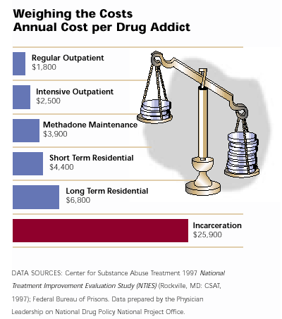
Notes:
Slide Sources: Center for Substance Abuse Treatment, 1997 National Treatment Improvement Evaluation Study (NTIES) (Rockville, MD: CSAT, 1997); Federal Bureau of Prisons. Data prepared by the Physician Leadership on National Drug Policy National Project Office.

Slide 93
How Long Should Treatment Last ?
Depends on patient problems/needs
Less than 90 days is of limited or no effectiveness for residential/outpatient setting
A minimum of 12 months is required for methadone maintenance
Longer treatment is often indicated
Notes:
RESEARCH
Individuals progress through drug addiction treatment at various speeds, so there is no predetermined length of treatment.
Slide Source: National Institute on Drug Abuse (NIDA) Teaching Packet No. 3: “Understanding Substance Abuse and Addiction: What Science Says” http://www.nida.nih.gov/pubs/teaching/Teaching3/Teaching4.html

Slide 94
Compliance & Chronicity
Chronic Illness | Medication Compliance | Relapse within 1 year
Diabetes | <60% | 30-50%
Hypertension | <40% | 50-70%
Asthma | <40% | 50-70%
Diet or Behavioral Changes | <30% | NA
McLellan AT, Lewis DC, O’Brien CP, Kleber HD; Drug Dependence, A Chronic Medical Illness, JAMA, Oct 4, 2000
Notes:
The same challenges as other diseases.
Slide Provided by: Peter Banys, M.D., Assoc. Clinical Prof. of Psychiatry, University of California at San Francisco, VA Medical Center, San Francisco.

Slide 95
But…For How Long?
One Year After Treatment
⇓ Drug selling 80%
⇓ Illegal activity 60%
⇓ Arrests down 60%
⇓ Trading sex for money or drugs 60%
⇓ Illicit drug use 50%
⇓ Homelessness 43%
⇓ Receipt of welfare 11%
⇑ Employment 20%
Notes:
Slide Source: Office on National Drug Control Policy, “ONDCP Drug Facts February 2002” Presentation.

Slide 96
How Long…?
Abstinence and Sobriety
Notes:
Slide Source: Office on National Drug Control Policy, “ONDCP Drug Facts February 2002” Presentation.

Slide 97
How Long…?
Five Years After Treatment (continued)
The numbers engaging in illegal activity are significantly reduced
⇓ 56% stealing cars
⇓ 38% breaking and entering
⇓ 38% injecting drugs
⇓ 30% selling drugs
⇓ 34% homeless
⇓ 23% victimizing others
Notes:
Slide Source: Office on National Drug Control Policy, “ONDCP Drug Facts February 2002” Presentation.

Slide 98
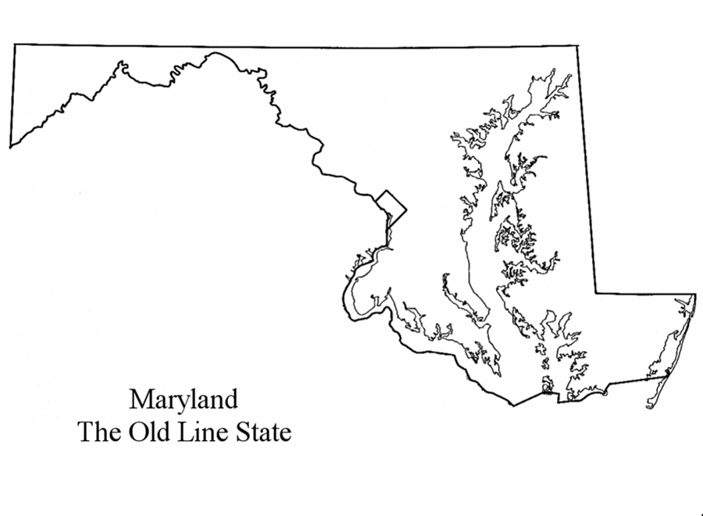
How Will I Know I’m Doing Better? How Will We Know?
MAAAP
What’s My Motivation?
Do I Feel Attached in a Healthy Way?
Do I Have a Positive Alliance?
Am I Working Up to My My Ability?
Do I Feel Like I’ve Got a Place in this World?
Am I On or Off
the MAAAP?

Slide 99
Facts About Addiction & Treatment
CHEMICAL DEPENDENCE IS A BRAIN DISEASE
THAT HAS
BIOLOGICAL, PSYCHOLOGICAL & SOCIAL COMPONENTS
Chronic, “cancerous” disorders require
multiple strategies and multiple episodes of intervention
TREATMENT WORKS IN THE LONG RUN
TREATMENT IS COST-EFFECTIVE
Notes:
Slide Source: Peter Banys, M.D., Assoc. Clinical Prof. of Psychiatry, University of California at San Francisco, VA Medical Center, San Francisco.

Slide 100
Question 12 and 13
What is the 1st Step of AA and NA?
What’s wrong with…
The Orioles?
The Nationals?
The Redskins?
The Wizards?

Slide 101
Thank You

