Slide 1
In
the
Name
of
god

Slide 2
Journal Club
COVID-19
Presenter: Nasrin Abdoli
Substance Abuse Prevention Research Center, Health Institute, Kermanshah University of Medical Sciences
Structural Equation Model (SEM)

Slide 3
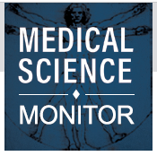
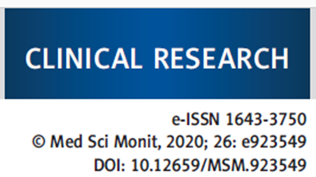
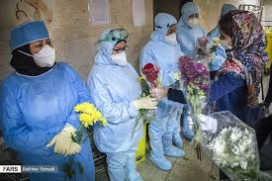
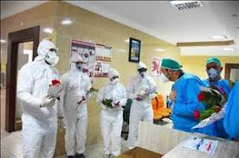
The Effects of Social Support on Sleep Quality of Medical Staff Treating Patients with Coronavirus Disease 2019 (COVID-19) in January and February 2020 in China
Han Xiao* Yan Zhang*Desheng Kong Shiyue Li Ningxi Yang

Slide 4
Xiao H. et al.: Medical staff treating COVID-19 © Med Sci Monit, 2020; 26: e923549
Background
Coronavirus disease 2019 (COVID-19), formerly known as severe acute respiratory syndrome coronavirus 2 (SARS-CoV-2) and 2019 novel coronavirus (2019-nCoV), was first identified in December 2019 in Wuhan City, China. Structural

Slide 5
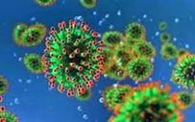
Xiao H. et al.: Medical staff treating COVID-19 © Med Sci Monit, 2020; 26: e923549
Objective
modeling (SEM) is a multivariate analysis method to determine the structural rela­tionship between measured variables. This observational study aimed to use SEM to determine the effects of social support on sleep quality and function of medical staff who treated patients with COVID-19 in January and February 2020 in Wuhan, China.

Slide 6
Xiao H. et al.: Medical staff treating COVID-19 © Med Sci Monit, 2020; 26: e923549
Methods
Study design An observational and cross-sectional clinical study was con­ducted that included the use of self-reported questionnaires. All questionnaires were com­pleted anonymously by the 180 participating medical staff.

Slide 7
Xiao H. et al.: Medical staff treating COVID-19 © Med Sci Monit, 2020; 26: e923549
Study participants
This study included 180 medical staff from several provinces who treated patients with COVID-19 infection in January and February 2020.
participants were either doctors or nurses who worked in departments of respiratory medicine, fever clinics, or the intensive care unit (ICU).
All study participants volunteered to participate in the study.

Slide 8
Xiao H. et al.: Medical staff treating COVID-19 © Med Sci Monit, 2020; 26: e923549
Ethical approval
The study was approved by the Wuhan University School of Medicine Ethics Committee (Approval number: 20180928).

Slide 9
Xiao H. et al.: Medical staff treating COVID-19 © Med Sci Monit, 2020; 26: e923549
Instruments 2
The Social Support Rate Scale (SSRS)
The SSRS contained ten items consisting of three grades, with an aggregate score that ranged from 7–56. The Cronbach’s alpha for internal con¬sistency for the use of the SSRS was 0.808.

Slide 10
Xiao H. et al.: Medical staff treating COVID-19 © Med Sci Monit, 2020; 26: e923549
Instruments 4
The General Self-Efficacy Scale (GSES)
the GSES was used to measure the feelings of self-efficacy by the medical staff The scale consisted of ten items, 1–4, and the total score of 10–40, The Cronbach’s al­pha for internal consistency for the use of the GSES was 0.805.

Slide 11
Xiao H. et al.: Medical staff treating COVID-19 © Med Sci Monit, 2020; 26: e923549
Instruments 6
The Pittsburgh Sleep Quality Index (PSQI)
The PSQI quality us­ing an 18-item scale included sleep quality, sleep duration, sleep latency, habitual sleep ,efficiency, sleep scored between 0–3, with a total score ranging from 0–21, The Cronbach’s alpha for internal consistency for the use of the PSQI was 0.811.

Slide 12
Xiao H. et al.: Medical staff treating COVID-19 © Med Sci Monit, 2020; 26: e923549
Statistical analysis
Data were presented as the mean ± standard deviation (SD). The chi-squared (C2) test, Pearson’s correlation analysis, and multivariate analysis.
Using the structural equation model (SEM) with path analysis were used to determine the structural re­lationship between the measured variables.

Slide 13
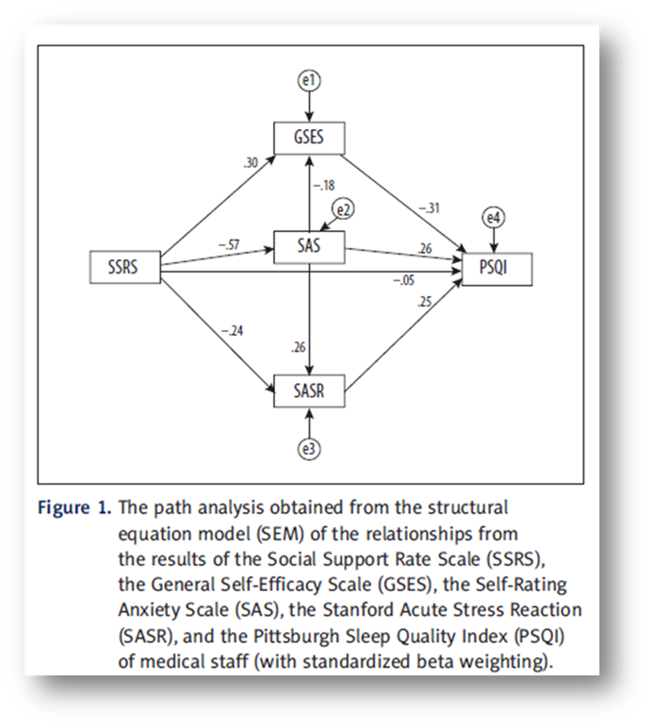
Xiao H. et al.: Medical staff treating COVID-19 © Med Sci Monit, 2020; 26: e923549
Structural Equation Model (SEM)

Slide 14
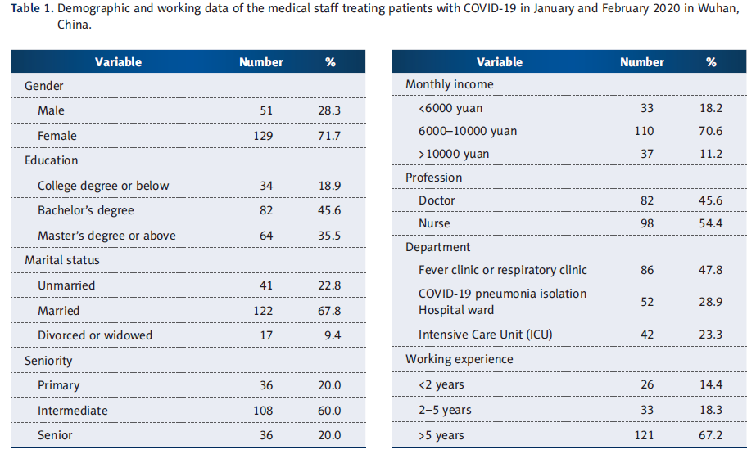
Xiao H. et al.: Medical staff treating COVID-19 © Med Sci Monit, 2020; 26: e923549
Results

Slide 15
Conculusion
Structural equation modeling (SEM) showed that medical staff had increased levels of anxiety, stress, and self-efficacy that were dependent on sleep quality and social support.

Slide 16
Thanks for your Attention

